Slide 1
Chapter 6 Section 1B
Solving 1-step Inequalities

Slide 2
Inequality symbols
Used to compare 2 non-equal values
Symbol Read as
< “ is less than”
> “ is greater than”
≤ “ is less than or equal to”
≥ “ is greater than or equal to”

Slide 3
Solving Inequalities
The solutions to an inequality is a range of numbers (is not just a single number)
Steps for solving:
  Perform opposite information to solve for the variable
  Draw a number line and label the key points
  Mark the appropriate dot (open or closed)
  Shade in the correct region

Slide 4
Examples:
1.
2.

Slide 5
Examples:
3.
4.

Slide 6
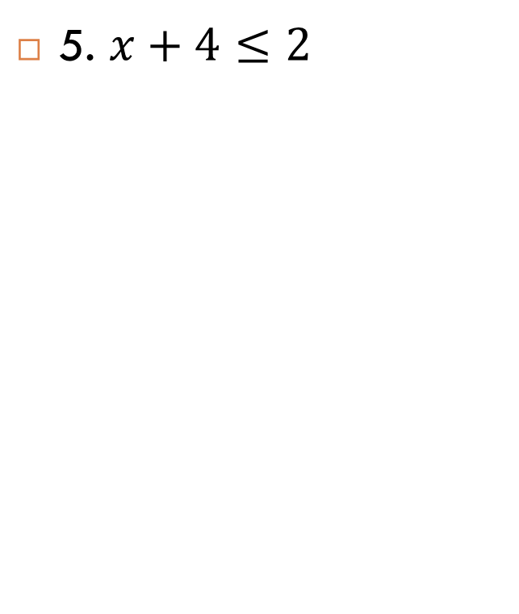
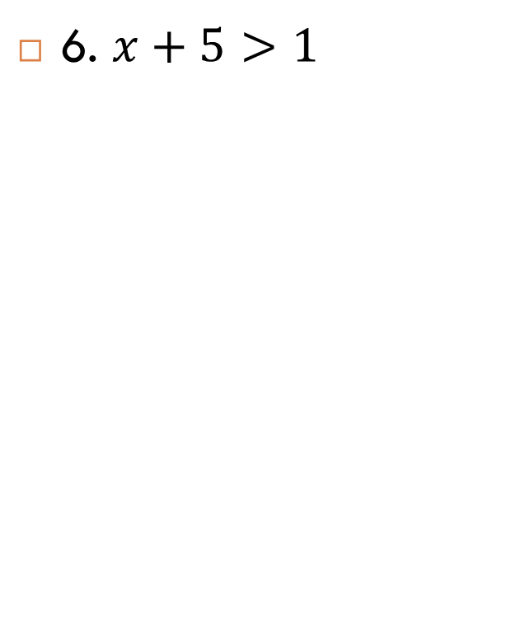
Examples

Slide 7
On your own
7. x +2 >-3
9. x -3 < -2
8. x-1< 0
10. x+2 > 9

Slide 8
Classwork
Blue book Page 171 # 1-10

